Slide 1
Prototype Presentation
Presented By:
Team “2”007 Britney Spears
Josh Attard, Veeram Hirekhan, Hassan Mehdi,
Maram Mohammed, Allison Ramasami, Srinivas Simhan

Slide 2
Overview of Project
Introduction:
The project involves automating Chocoholics Anonymous data processing and storage to speed up their current manual processes.
Purpose of Design Document:
Describes all data, architectural, interface and component-level design for the software.
A design specification provides explicit information about the requirements for a product and how the product is to be put together.

Slide 3
Overview of Project (cont.)
Goals:
Automate the various processes at ChocAn that are currently being done manually.
Centralize all member and provider information in a database, located at a ChocAn data center. The data will be accessible remotely through ChocAn terminals available to ChocAn employees as well as all providers.
Database will then be used to automatically generate reports for members, providers, and managers every week.
Objectives:
Create a database to store member and provider data
Create software to process membership payments and determine membership status
Create front-end for providers to enter service information into and obtain provider directory
Create front-end for operators to modify member/provider data
Create software to generate reports for members, providers, and managers
Design ChocAn terminals
Create software that allows terminal to communicate with data center

Slide 4
Description of Rapid Prototype
Our rapid prototype includes the AWS database of all users (members or providers) and have statuses on the members.
The prototype will also send out emails with attached reports at designated time-slots (Friday at Midnight).
It will also record simulated services being provided and save that information into the database.

Slide 5
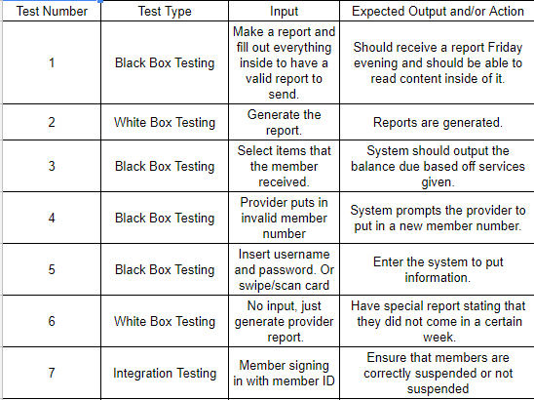
Test Plan

Slide 6
Demo Project

Slide 7
Thanks for listening!
Any questions?

